Slide 1
IT1020 – Introduction to computer systems
Lecture 1:
History/ Evolution and the components of the Computer Systems

Slide 2
Lecture content
Generations of Computers
Characteristics of each Generation
Components of Computers
Different types of components
2

Slide 3
Generations of the Computers
1st Generation computers(1944-1955)
2nd Generation computers (1955-1964)
3rd Generation computers (1964-1971)
4th Generation Computers (1971- Present )
5th Generation Computers (Present and Beyond)
3

Slide 4
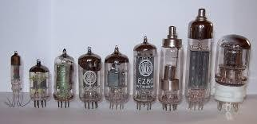
1st Generation Computers (1944-55)
Main characteristics of this generation
Used Thermion valves
Large in size and very heavy in weight
Power consumption was very high
First Generation Computers relied on Machin Language
Writing program on them was difficult or quite slow
They were very expensive to operate, using a great deal of electricity, generated a lot of heat, which was often the cause of malfunctions
4

Slide 5
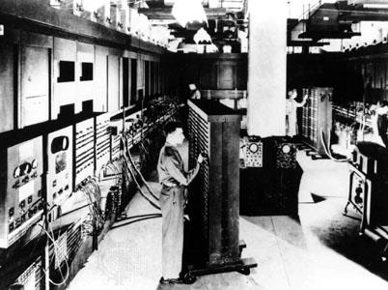
1st Generation Computers
Electronic Numerical Integrator and Calculator (ENIAC)
1946 : First electronic general purpose calculator, ENIAC was built in U.S, weighs 33 tons, consumes 150kw, and averages 5000 operations per second
5

Slide 6
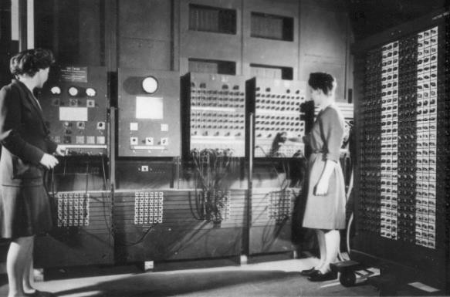
1st Generation Computers
Hard wired programming
Early computers were programmed, using large number of switches in the console panel and plugging/unplugging cables
It is called hardwired programming
Two women working with ENIAC computer
United States Army Photo.
6

Slide 7
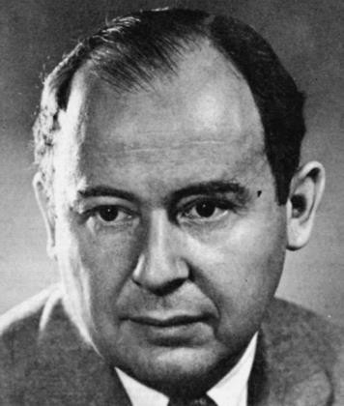
1st to 2nd generation
Von Neumann Architecture
It was required re-wire and re-design the machine to run a different program. It was a manual and very tedious task
Von Neumann proposed that programs and data can be stored in a memory device and instead of rewiring the machine we can change the program easily.
John Von Neumann
8

Slide 8
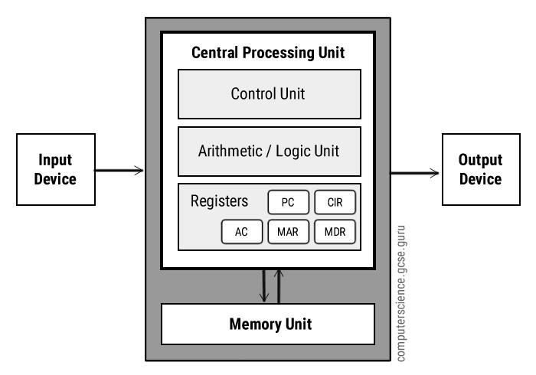
1st to 2nd generation
Von Neumann Architecture
All computers share the same basic architecture, whether it be a multi-million dollar mainframe or a Palm Pilot.
All have memory, an I/O system, and arithmetic/logic unit, and a control unit.

Slide 9
1st to 2nd generation
Von Neumann Architecture
The use of the binary number system
A single sequentially addressed memory
A separate arithmetic/logic unit for performing arithmetic and logical computations
The stored program concept in which both the programs and its data are stored in memory.
A controller that fetches instructions from memory and executes them.

Slide 10
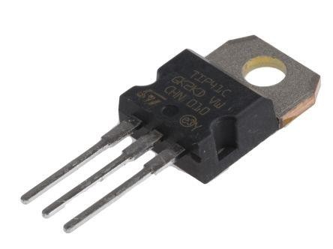
1st to 2nd generation
Invention of Transistor
1947 : Transistor, essential storage device for computers invented at Bell Labs by American engineers William Shockley, John Bardeen and Walter Bartain .
Transistors were much smaller, more rugged, cheaper to make and far more reliable than valves.

Slide 11
2nd Generation Computers (1955-64)
Used transistors instead of Thermion valves.
Comparatively higher operating speed.
Size and weight of the computers decreased
Manufacturing cost reduced
The concepts of Central Processing Unit (CPU), memory, programming language and input and output unites were developed.

Slide 12
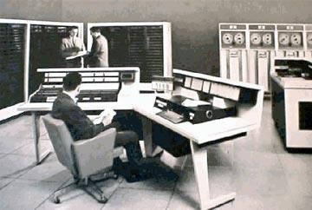
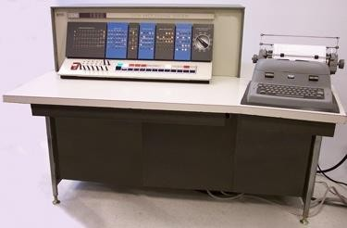
2nd Generation Computers (1955-64)
High-level programming languages introduced
Development of software for computers
Computer industry experienced rapid growth.
IMB 1401
IMB 1620

Slide 13
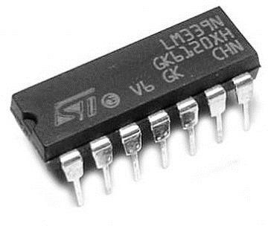
3rd Generation Computers(1964-71)
Integrated Circuits (ICs) were used (A single IC has many transistors, resisters and capacitors built on a single thin slice of silicon.)
The size of the computer got further reduced
High Level Languages were developed in this generation
Large IC companies were started. (INTEL started in 1968, AMD started in 1969)
The computers were low cost, large memory and
processing speed was very high.

Slide 14
3rd Generation Computers(1964-71)
Substantial operating systems were developed to manage and share the computing resources and time sharing operating systems were developed. These greatly improved the efficiency of computers.
Computers had by now pervaded most areas of business and administration.
Allowed the device to run many different applications at one time.

Slide 15
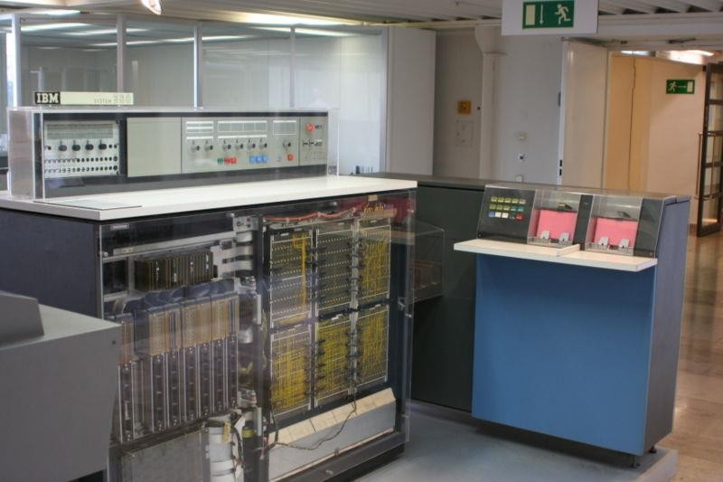
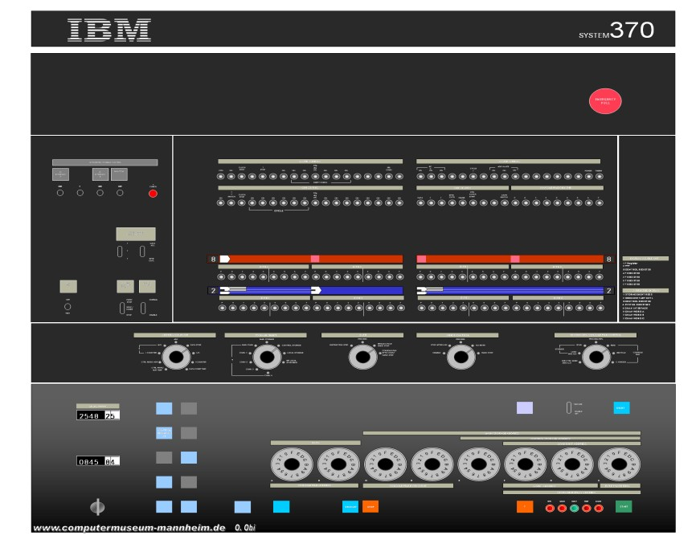
3rd Generation Computers(1964-71)
IBM System/360
IBM System/370

Slide 16
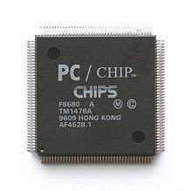
4th Generation Computers (1971-)
Personal computers were developed and IBM launched the Power PC and Pentium introduced the 8088 and 8086 microprocessors. (Most of the computers at present are belong to this generation)
It uses large scale Integrated Circuits (LSIC) built on a single silicon chip called microprocessors.
Memory chips are in megabit range

Slide 17
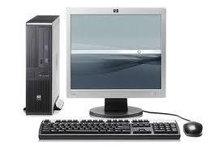
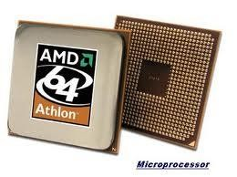
4th Generation Computers (1971-)
On the software side, more powerful operating systems are available such as Unix.
Fourth generation languages (4GLs) make the development process much easier and faster.
Applications software has become cheaper and easier to use.
Software development techniques have vastly improved.

Slide 18
5th Generation Computers
Present and beyond
Fifth generation computing devices, based on Artificial Intelligence (AI).
Are still in development, though there are some applications, such as voice recognition.
The use of parallel processing and superconductors is helping to make artificial intelligence a reality.
The goal of fifth-generation computing is to develop devices that respond to natural language input and are capable of learning and self-organization.

Slide 19
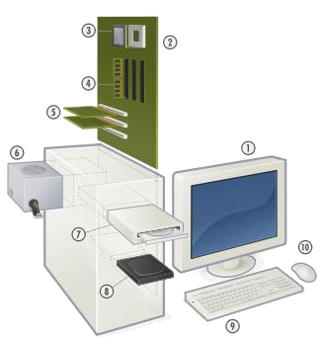
Components of the Computer
Input devices
Output devices
Processing devices
Storage devices
Other devices
– Motherboard, Expansion cards, Power supply

Slide 20
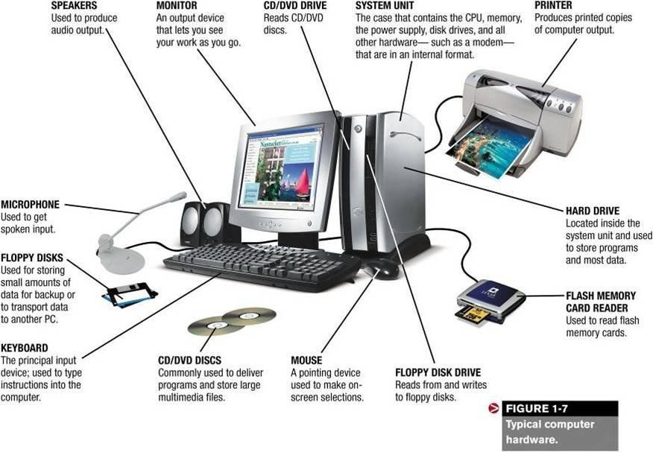
Components of the Computer Basic layout

Slide 21
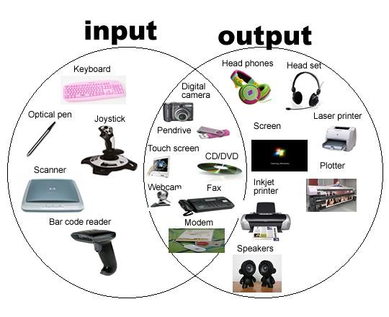
Components of the Computer - Input and output devices

Slide 22
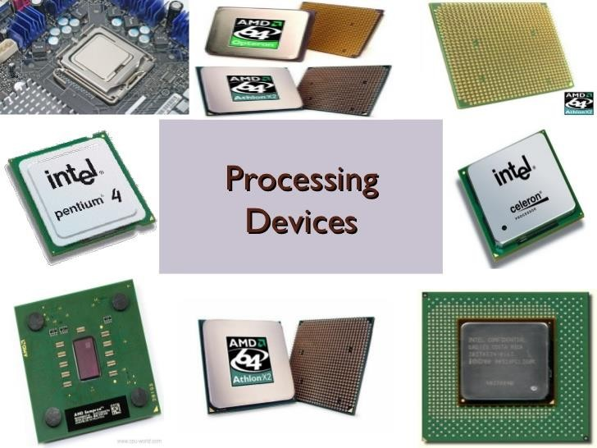
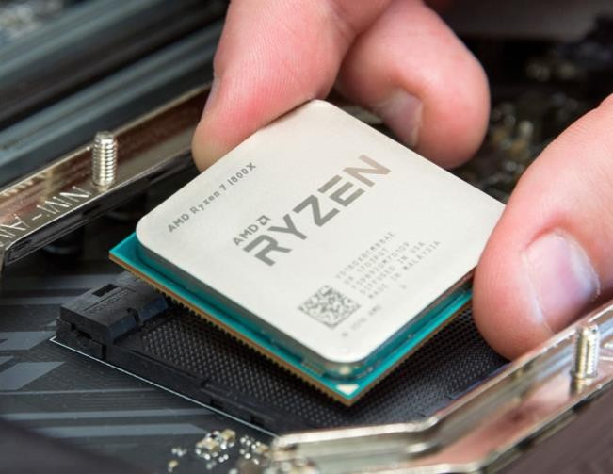
Components of the Computer -Processing devices

Slide 23
Components of the Computer Storage Devices – Features
Volatility
Volatile storage
Non-Volatile storage
Accessibility
Random access
Sequential access
Mutability
Read/write storage or mutable storage
Read only storage
Slow write, fast read storage
Addressability
Location addressable
File addressable
Content addressable

Slide 24
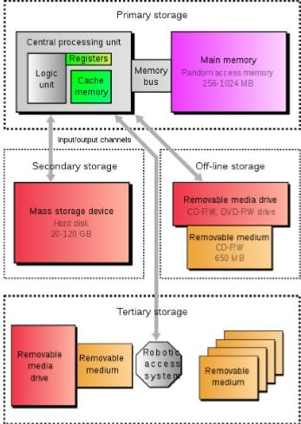
Components of the Computer Storage Devices – Types
There are four type of storage:
Primary Storage
Secondary Storage
Tertiary Storage
Off-line Storage
External storages
I/O
module
Main memory
Magnetic Disks
CPU
Cache

Slide 25
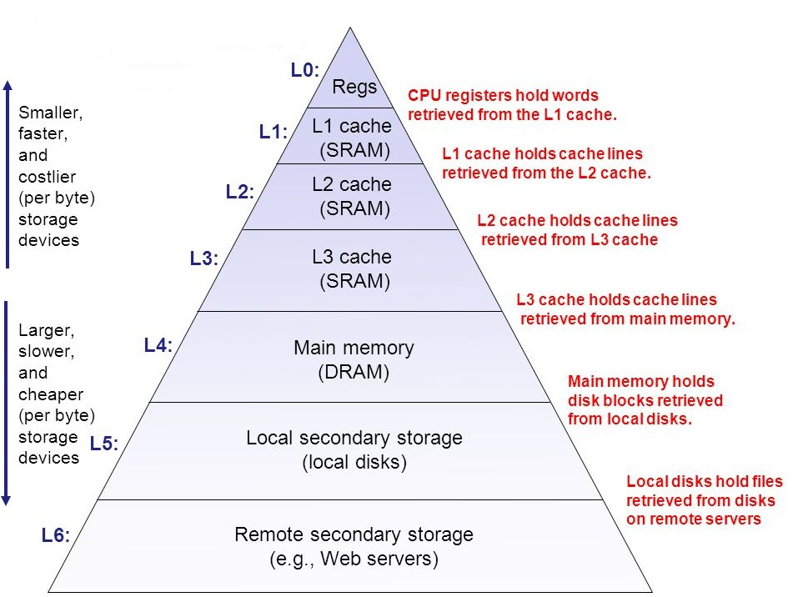
Components of the Computer Storage Devices – Hierarchy
Volatile Random access
Non-volatile

Slide 26
Components of the Computer Storage Devices – Primary storage
Primary storage types
Registers
Main Memory
Cache

Slide 27
Components of the Computer Storage Devices – Primary storage
Registers
very small amount of very fast memory that is built into the CPU
This is to speed up its operations by providing quick access to commonly used values.
Fastest memory in computer.
Registers are normally measured by the number of bits they can hold, for example, an 8-bit register or a 32-bit register.
Registers can also be classified into
general purpose
special purpose.

Slide 28
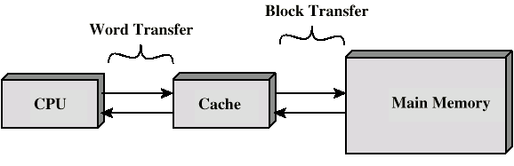
Components of the Computer Storage Devices – Primary storage
Cache
Small amount of fast memory (Faster than RAM, static memory)
Sits between normal main memory and CPU
May be located on CPU chip or module.
Cache works on the principal of locality of reference.

Slide 29
Components of the Computer Storage Devices – Primary storage
Cache – The operation of cache memory
Main Memory (DRAM)
1. Cache fetches data from next to current addresses in main memory
2.CPU checks to see whether the next instruction it requires is in cache
CPU
Cache Memory (SRAM)
4. If not, the CPU has to fetch next instruction from main memory - a much slower process
3. If it is, then the instruction is fetched from the cache – a very fast position

Slide 30
Components of the Computer Storage Devices – Primary storage
Memory – technologies
Static memory | Dynamic memory
No charges to leak No refreshing needed when powered More complex construction Larger implementation per bit More expensive Faster that dynamic memory | Bits stored as charge in capacitors Level of charge determines value - charges leak Need refreshing even when powered (need refresh circuits) Simpler construction, smaller per bit Less expensive Slower than Static memory

Slide 31
Components of the Computer Storage Devices – Primary storage
Memory – types
Read Only Memory (ROM) | Random Access Memory (RAM) Also called read/write memory.
Non-volatile in nature These cannot be accidentally changed Use static memory Faster than dynamic memory E.g. BIOS chip Masked ROM Programmable ROM (PROM) Erasable PROM (EPROM) EEPROM | Volatile This is a semi conductor memory (dynamic memory) E.g. Main memory Main memory is usually called RAM. (misnamed because all semiconductor memory is random access) Main Memory can be made faster by using static memory. Then why don’t we do that? Main memory is directly or indirectly connected to the central processing unit via a bus. The CPU continuously reads instructions stored in the main memory and executes them as required. 33

Slide 32
Components of the Computer Storage Devices – Primary storage
Memory – Main memory
Main memory consists of a number of storage locations, each of which is identified by a unique address
The ability of the CPU to identify each location is known as its addressability
Each location stores a word i.e. the number of bits that can be processed by the CPU in a single operation. Word length may be typically 16, 24, 32 or as many as 64 bits.

Slide 33
Components of the Computer Storage Devices – Primary storage
Memory – Main memory
Program and data are stored in memory prior to execution.(This is called Stored Program Concept proposed by Von Neumann).
Memory is a semiconductor device in modern computers (Magnetic core memories were used earlier)
Main memory, primary storage are synonyms to memory. (RAM also denotes the same)

Slide 34
Components of the Computer Storage Devices – Primary storage
Memory – Main memory
Memory is byte addressable
Each byte has a unique address
Addresses start from zero and increment sequentially.
Memory Refresh – Memory refresh is the process of periodically read data from an area of computer memory and immediately writing the read information to the same area with no modifications.

Slide 35
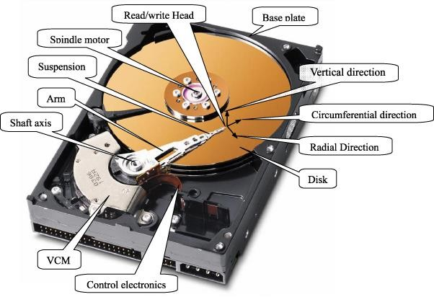
STORAGE DEVICES – SECONDARY STORAGE
Hard disk

Slide 36
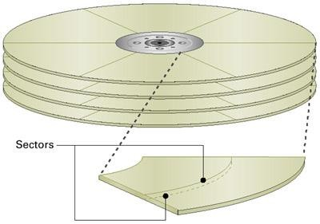
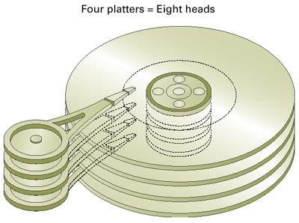
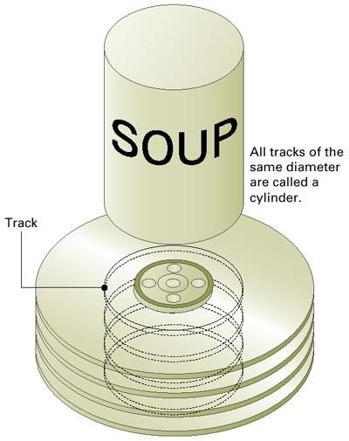
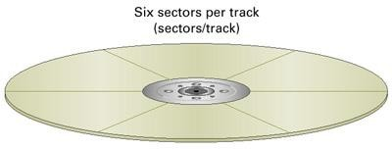
Components of the Computer Storage Devices – Secondary storage
Hard disk

Slide 37
Components of the Computer Storage Devices – Secondary storage
Hard disk – performance parameters
Access time – seek time + rotational delay+ transfer time
Seek time – track selection time (moving the head on the desired sector on the track)
Rotational delay – the time it takes for the head to reach the beginning of the sector
Transfer time – the time required to transfer data

Slide 38
Components of the Computer Storage Devices – Tertiary Storage
Typically, it involves a robotic mechanism which will mount (insert) and dismount removable mass storage media into a storage device.
It is a comprehensive computer storage system that is usually very slow, so it is usually used to archive data that is not accessed frequently.
This is primarily useful for extraordinarily large data stores, accessed without human operators.

Slide 39
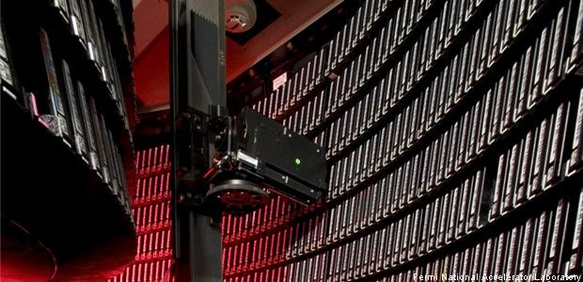
Components of the Computer Storage Devices – Tertiary Storage

Slide 40
Components of the Computer Storage Devices – Offline Storage
Also known as Disconnected storage
Is a computer data storage on a medium or a device that is not under the control of a processing unit
It must be inserted or connected by a human operator before a computer can access it again
Examples
Floppy Disk
CD/DVD/Blue-ray
USB Flash Drive
Memory Cards

Slide 41
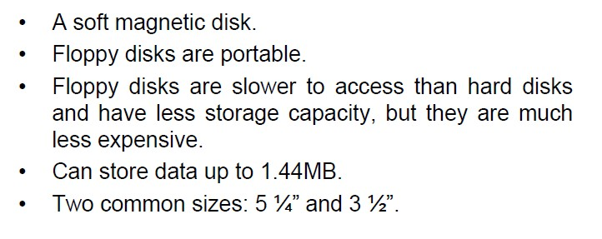
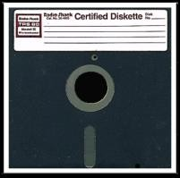
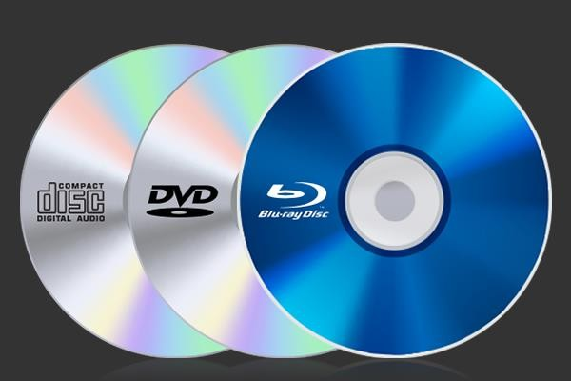
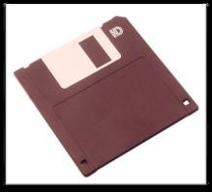
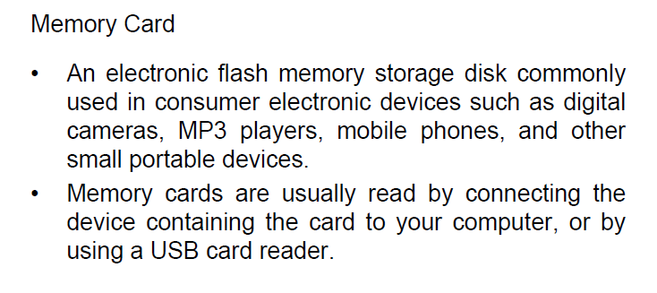
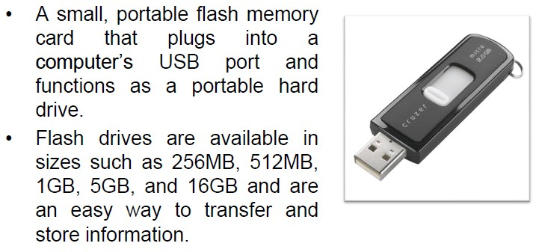
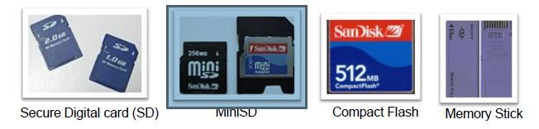
Components of the Computer Storage Devices – Offline Storage

Slide 42
Components of the Computer Storage Devices – Offline Storage
 | CD | DVD
Stands for | Compact Disc | Digital Versatile Disc
Purpose | CDs are made with the purpose of holding audio files as well as program files. | DVDs are made with the purpose of holding video files, movies, substantial amount of programs, etc.
Media type | Optical disc | Optical disc
Capacity | Typically up to 700 MiB (up to 80 minutes audio) | DVD can range from 4.7 GB to 17.08 GB.
Types | CD-R, CD-RW, CD-Text ETC. | DVD-RW, DVD+RW, DVD-RAM and Blu-Ray. 45

Slide 43
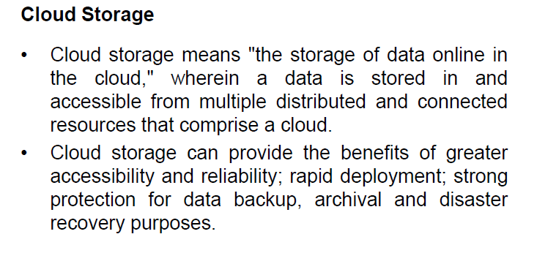
Components of the Computer - Storage Devices
Other Storage techniques

Slide 44
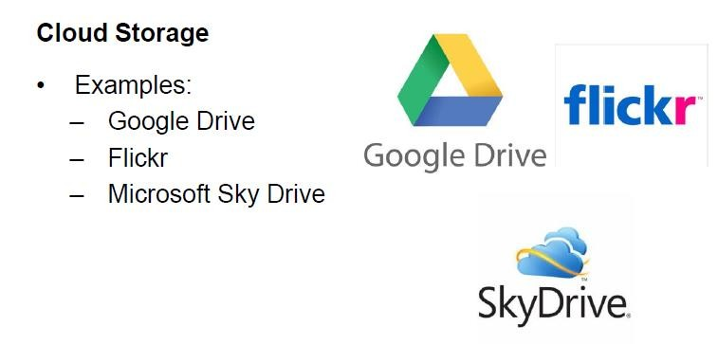
Components of the Computer Storage Devices
Other Storage techniques

Slide 45
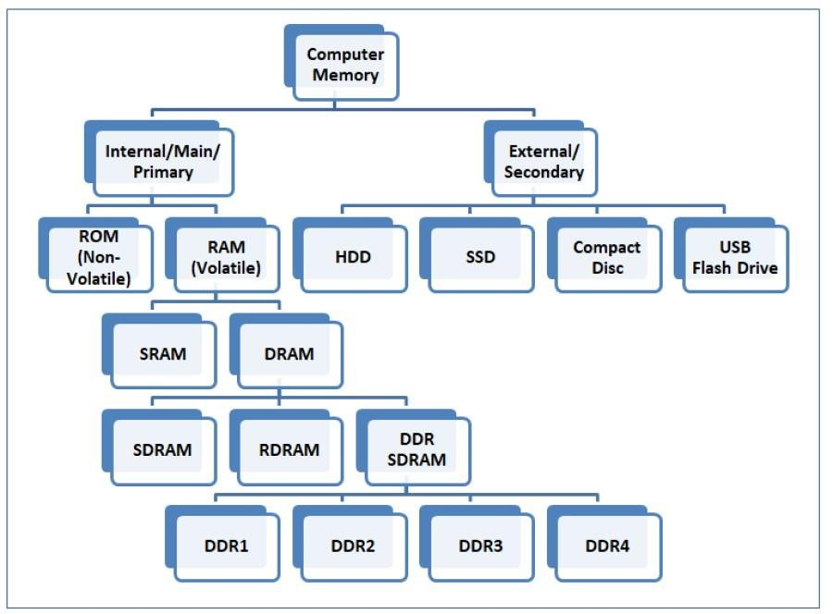
Components of the Computer Storage Devices
Evolution of storages

Slide 46
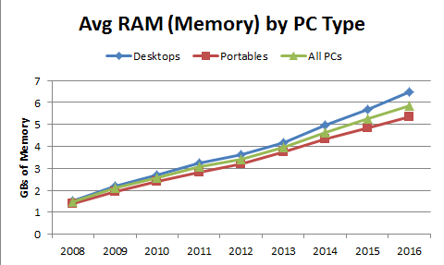
Components of the Computer Storage Devices
Evolution of storages

Slide 47
THANK YOU

